Slide 1
Module 8
Visualizing Stamen maps with ggmap

Slide 2
Contents
• Creating a basemap
• Adding operational layers
• Multilayered Plot with ggmap.

Slide 3
Exercise 1: Creating a basemap – stamen background
# Library
library(ggmap)
library(gridExtra)
# For stamen map, you have to give the extremity of the window you are looking at. here is an example with the watercolor background (Around brisbane)
map <- get_stamenmap( bbox = c(left = 110, bottom = -40, right =160, top = -10), zoom = 4, maptype = "watercolor")
ggmap(map) + theme_void() + theme( plot.title = element_text(colour = "orange"), panel.border = element_rect(colour = "grey", fill=NA, size=2) )

Slide 4
Exercise 2 : Adding Operational data layers
Use get_stamenmap() to plot the longitude/latitude maps.
The data for the following plots is available at
https://simplemaps.com/data/us-cities.
The get_stamenmap() function reqiures a bounding box, i.e the top, bottom, left and right latitude/longitude of the map you want to plot.
bbox <- c(bottom = 25.75, top = 49 , right = -67, left = -125)

Slide 5
Exercise 2(cont…)
You can find these values from https://www.openstreetmap.org.
The other important parameters of this function are zoom and map type. Higher the zoom level, the more detailed plot.
Download the map by connecting ggmap to Stamen Map.
Downloading of the map will take some time when the zoom level is high.
The different types of plots available via Stamen Map are terrain, watercolor, toner which can be set to map type parameter.

Slide 6
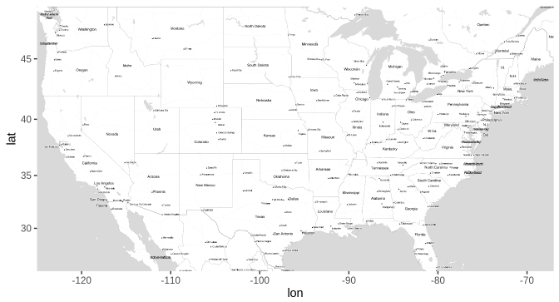
Exercise 2(cont…)
library(ggmap)
usmap <- get_stamenmap(bbox = bbox, zoom = 6, maptype = 'toner-lite')
ggmap(usmap)

Slide 7
Exercise 2(cont…)
Load the dplyr package: library(dplyr)
df <- read.csv('uscities.csv')
# Removing data of Alaska from dataset
df <- df %>% filter(state_name != 'Alaska')
# Spread of counties across US using points
A county is a geographical region of a country used for administrative or other purposes in certain modern nations.

Slide 8
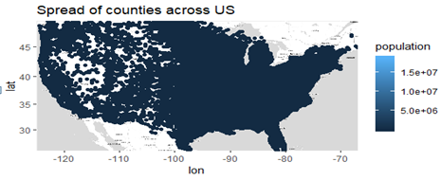
Exercise 2(cont…)
ggmap(usmap) + geom_point(data = df, mapping = aes(x = lng, y = lat, color = population)) + ggtitle('Spread of counties across US')

Slide 9
Exercise 2(cont…)
As can seen in the above graph, most of the points are overlapping and thus it is not easy to interpret what’s going on.
So try alpha blending and reduce the size of points.
# Spread of counties across US using points
ggmap(usmap) + geom_point(data = df, mapping = aes(x = lng, y = lat, color = population), size = 0.8, stroke= 0, alpha = 0.4) + ggtitle('Spread of counties across US')

Slide 10
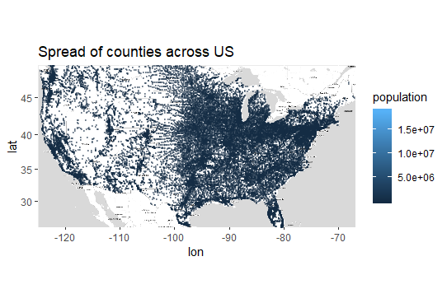
Exercise 2(cont…)

Slide 11
Exercise 2(cont…)
In the above plot there is no light blue dot visible on the plot.
This is because it must be lying somewhere between those dense areas.
Another reason is that when you use alpha blending, your colors fade and thus it becomes difficult to identify such points.
So use geom_density to get insight of spread of counties.
# spread of counties across US using Density_2d
ggmap(usmap) + geom_density_2d(data = df, mapping = aes(x = lng, y = lat, color = population)) + ggtitle('Spread of counties across US')

Slide 12
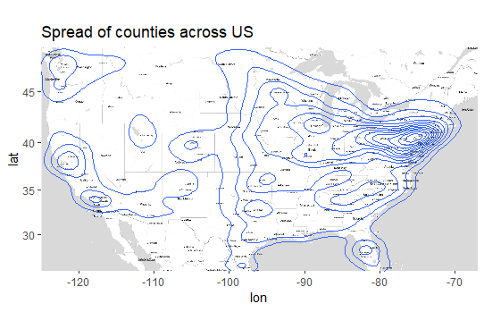
Exercise 2(cont…)

Slide 13
Exercise 3 : Multilayerd plots with ggmap
Multiple layers can be added to the plot. For example: Adding the location of military stations located across US along with population density.
# Location of Military units
df1 <- df %>% filter(military == TRUE)
ggmap(usmap) + geom_point(data = df, mapping = aes(x = lng, y = lat, color = population, text = city), show.legend = F, size = 0.8, stroke= 0, alpha = 0.4) + geom_point(data = df1, mapping = aes(x = lng, y = lat , text = city), show.legend = F, size = 0.9, color = 'red') + ggtitle('Military stations across US')

Slide 14
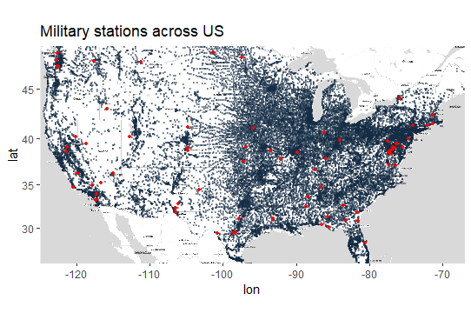
Exercise 3 : Multilayerd plots with ggmap (cont…)
Notes:
there are 3 layers in this plot. First base layer consists of US map, second layer consists of spread of counties across US and the third layer consists of location of military bases. It is not easy to plot such multilayered graphs using other packages.

Slide 15
Conclusion
In the exercise 2, 3 layers are added to the plot.
First base layer consists of US map,
Second layer consists of spread of counties across US and
Third layer consists of location of military bases.
It is not easy to plot such multilayered graphs using other packages.

